Slide 1
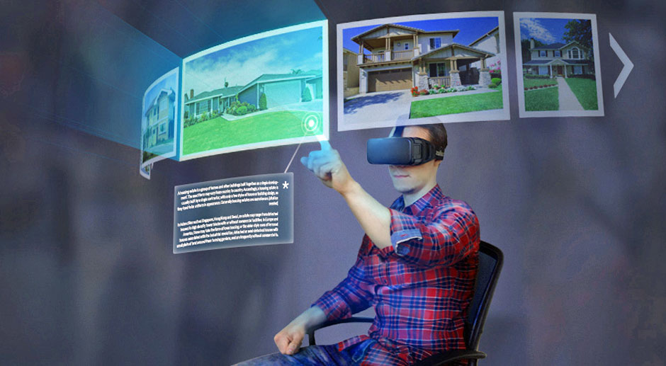
Virtual reality
Made by: Jelle Olthof
PICT-4v1B

Slide 2
What are we going to talk about?
Introduction
What is VR?
Who made it?
Some clips
Something interesting + Important information
A little quiz.
The end

Slide 3

Introduction
Why VR?
What’s the point of VR?

Slide 4
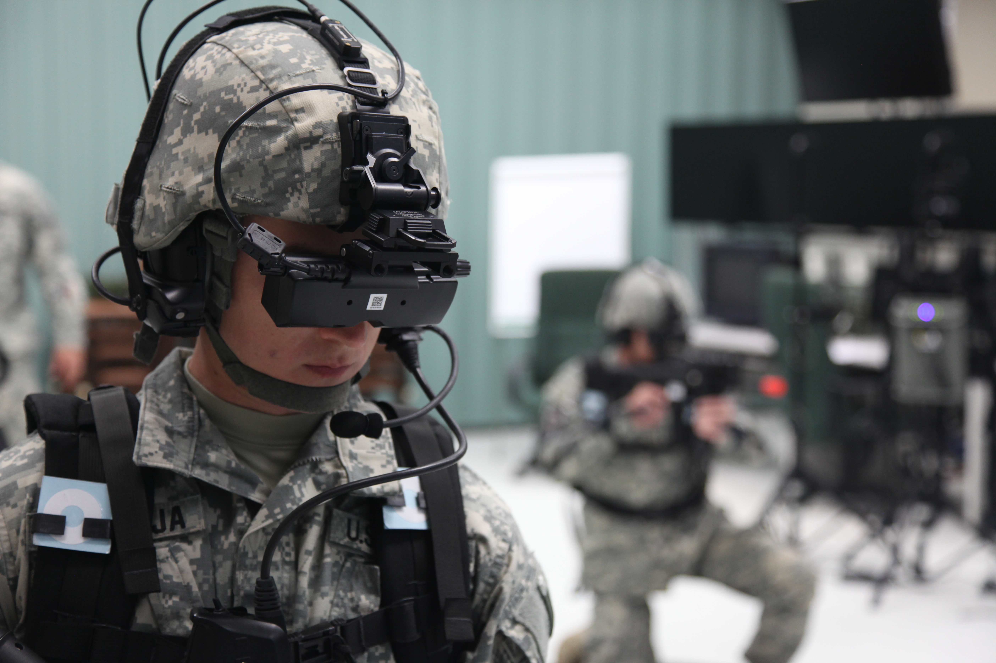
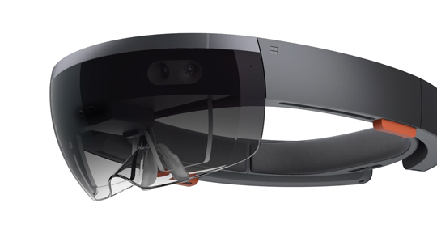
What is VR?
VR = Virtual reality…
360° Holographic lens
Used mostly for gaming.
Frequently used by militairy for practice.
More used for building purposes. (Think about hololens)

Slide 5
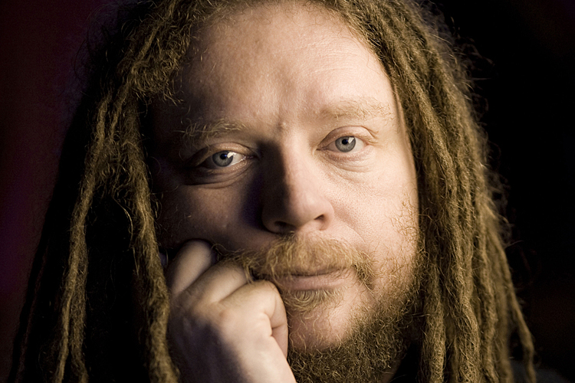
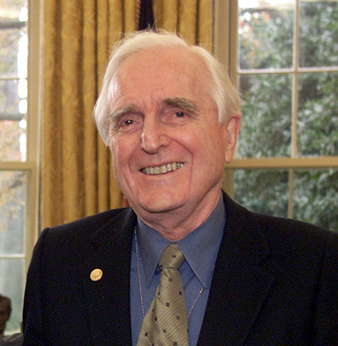
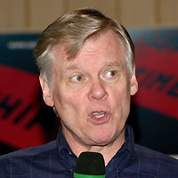
Who invented VR?
Jaron Lanier
Douglas Engelbart
Helped developing VR
Insteresting fact: he also built the first ever mouse
Ivan Sutherland
Built the first VR Headset
Myron Krueger
Is known for his “Installation arts”

Slide 6

SOME CLIPS

Slide 7
Virtual reality with google cardboard

Slide 8
Clips with 360°

Slide 9
Something interesting?
What are we / you going to do?
IMPORTANT INFORMATION; If u have ANY health issues, u should not do this. (includes, epilepsy, etc.)
If u feel dizzy while wearing a VR glass, u should Immediately turn off the VR glass.
If u are not comfortable (feeling something strange. Etc.) wearing it, u should also stop.
Let’s have some fun!
DISCLAIMER: The “Google cardboard” is only available on Samsung Galaxy s4 (+) This google cardboard and smartphone belongs to someone else, so please go easy on it.
DISCLAIMER(2): Today we are only going to be watching YouTube videos. Because that’s the only thing a phone can handle in 360°.

Slide 10
A quiz!
If u had paid attention to this presentation, you can answer all of these questions!
Let’s begin

Slide 11
Question 1
Who were the developers of VR (name atleast 1)
Answer:
Myron Krueger
Ivan Sutherland
Douglas Engelbart
Jaron Lanier

Slide 12
Question 2
What is VR used for. (Tip: 3 possibilities)
Answer:
Gaming
Building
Training for militairy

Slide 13
Question 3
What are your thoughts about virtual reality?
If u have/had the money, would u buy it?

Slide 14
The end
That’s all I’ve got for u. I hope u liked it!

